Slide 1
Numerical Modeling of 2D Plasma Lenses
Gianfranco Grillo
Cornell University

Slide 2
Relevance
Explain timing/DM events, such as those observed in J1713-0747.
Might help explain occurrence of certain FRBs.
Small lensing events could account for some of the residuals in our timing models, by introducing errors in our DM estimations.

Slide 3
J1713-0747 Events
Dips in ΔDM(t) curve. Two events of ~120 days duration, one in 2008, the other in 2016. Lens orbiting host pulsar?
Both events last for similar amounts of time and have similar shapes. The magnitude of the change in DM is ~6×10⁻⁴ pc cm⁻³ in both cases.

Slide 4
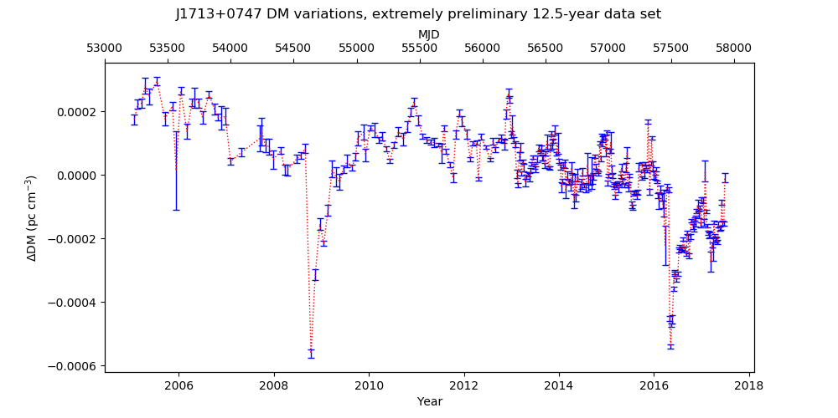

Slide 5
Lensing Effects
The presence of a lens along the line of sight directly affects two quantities: the intensity of the pulse and the frequency dependent pulse arrival time.
The effect on pulse arrival time also translates into errors in our estimation of the dispersion measure.
Furthermore, it can result in the observation of multiple images at the observer's position.

Slide 6
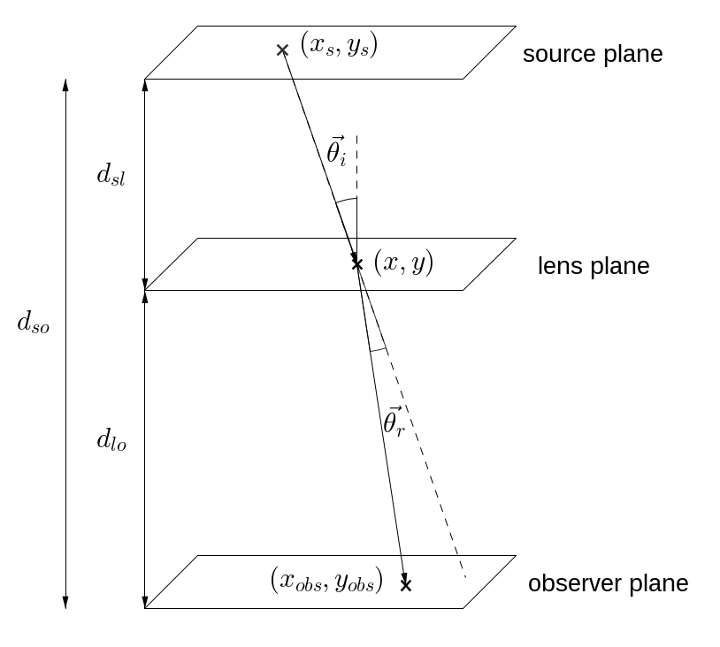
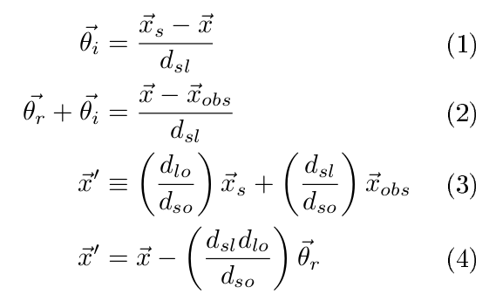
Lensing Geometry

Slide 7
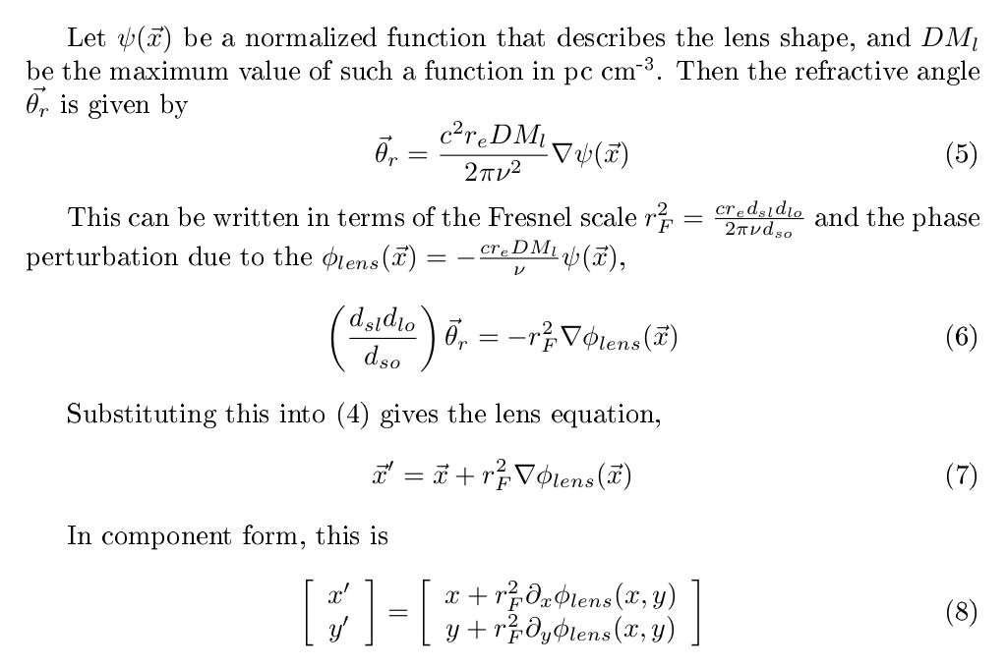

Slide 8
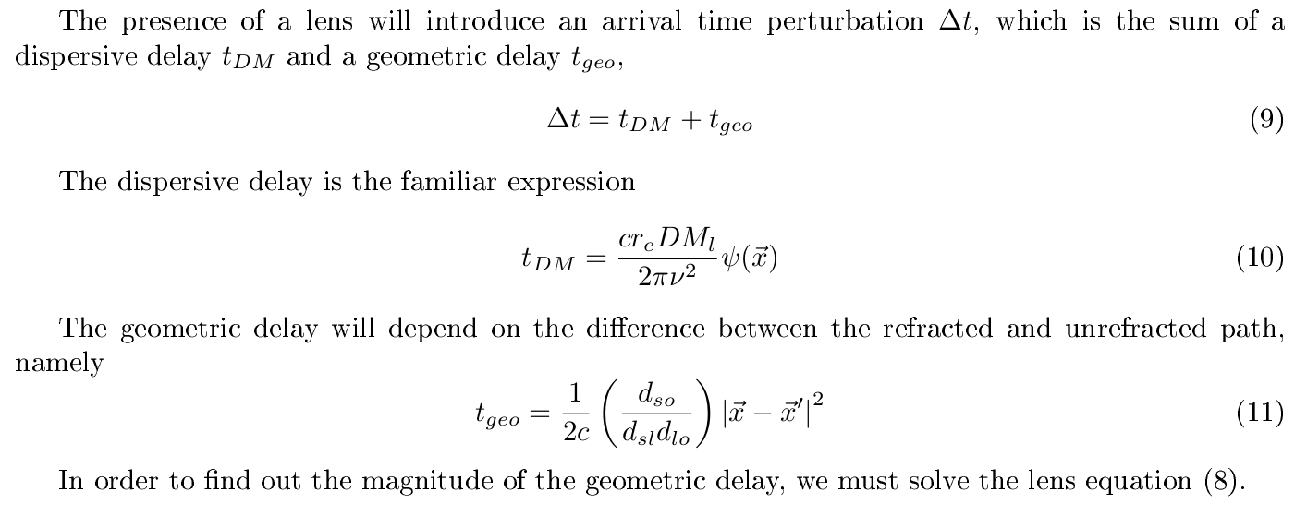
Arrival Time Perturbation

Slide 9
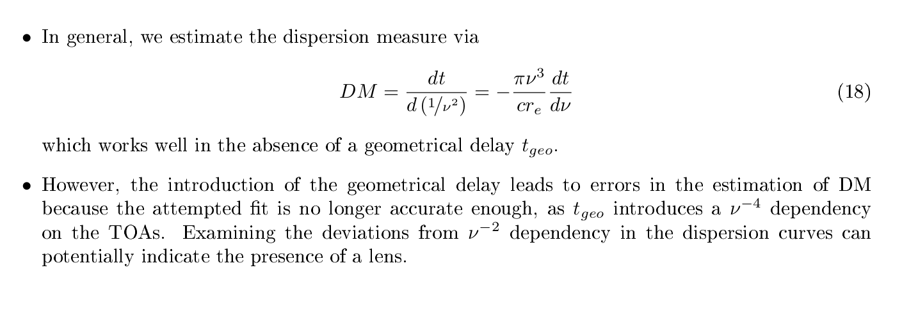
Dispersion Measure Perturbation

Slide 10
Solving the Lens Equation
Two dimensional root finding problem (unless lens shape is trivial). Tricky in part because there can be more than one solution when the refraction of the rays results in multiple images.
Fortunately, it is possible to determine the locations at which multiple images are produced, as a function of a given parameter. These locations are related to the way the lens gain varies.

Slide 11
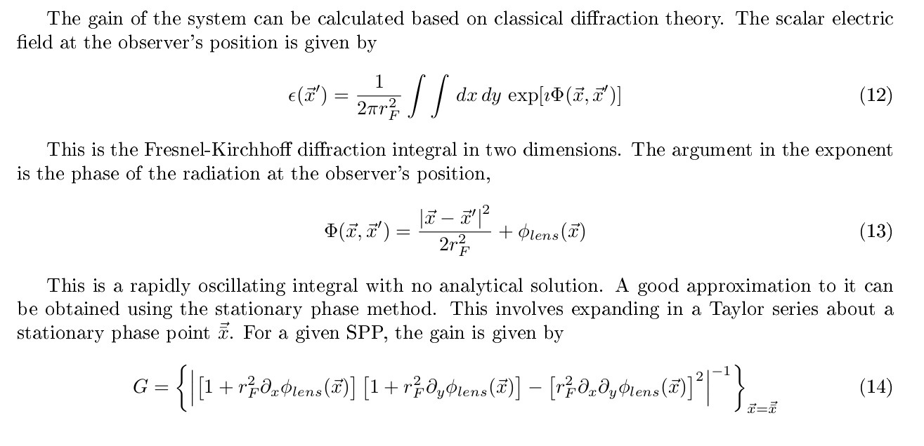
The Fresnel-Kirchoff Diffraction Integral

Slide 12
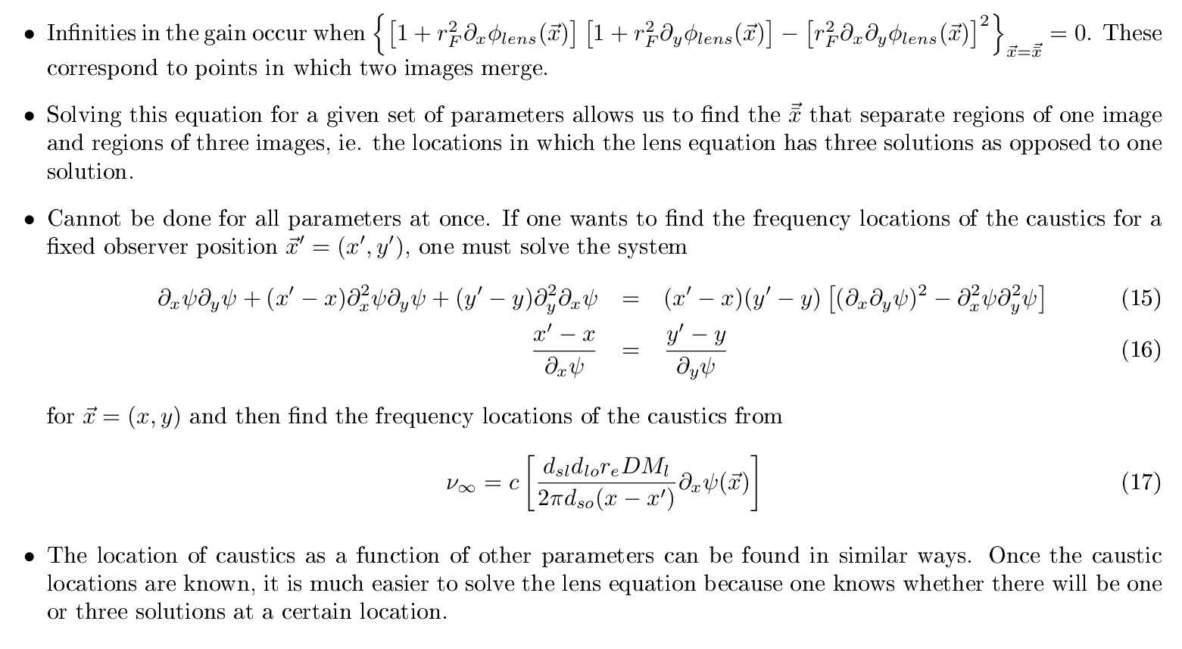
Infinities in the Gain: Caustics

Slide 13
Difficulties
Finding the caustics can be tricky, and needs to be done numerically. Sometimes no caustics exist for a particular set of parameters.
Even if one is able to find the caustics, and therefore knows the ranges in which multiple images occur, one needs to provide initial guesses. Can be computationally expensive.

Slide 14
Difficulties
Very hard to write general code that can handle any kind of lens shape.
Will probably have to supplement with a Montecarlo ray tracing approach.

Slide 15
Some Results

Slide 16
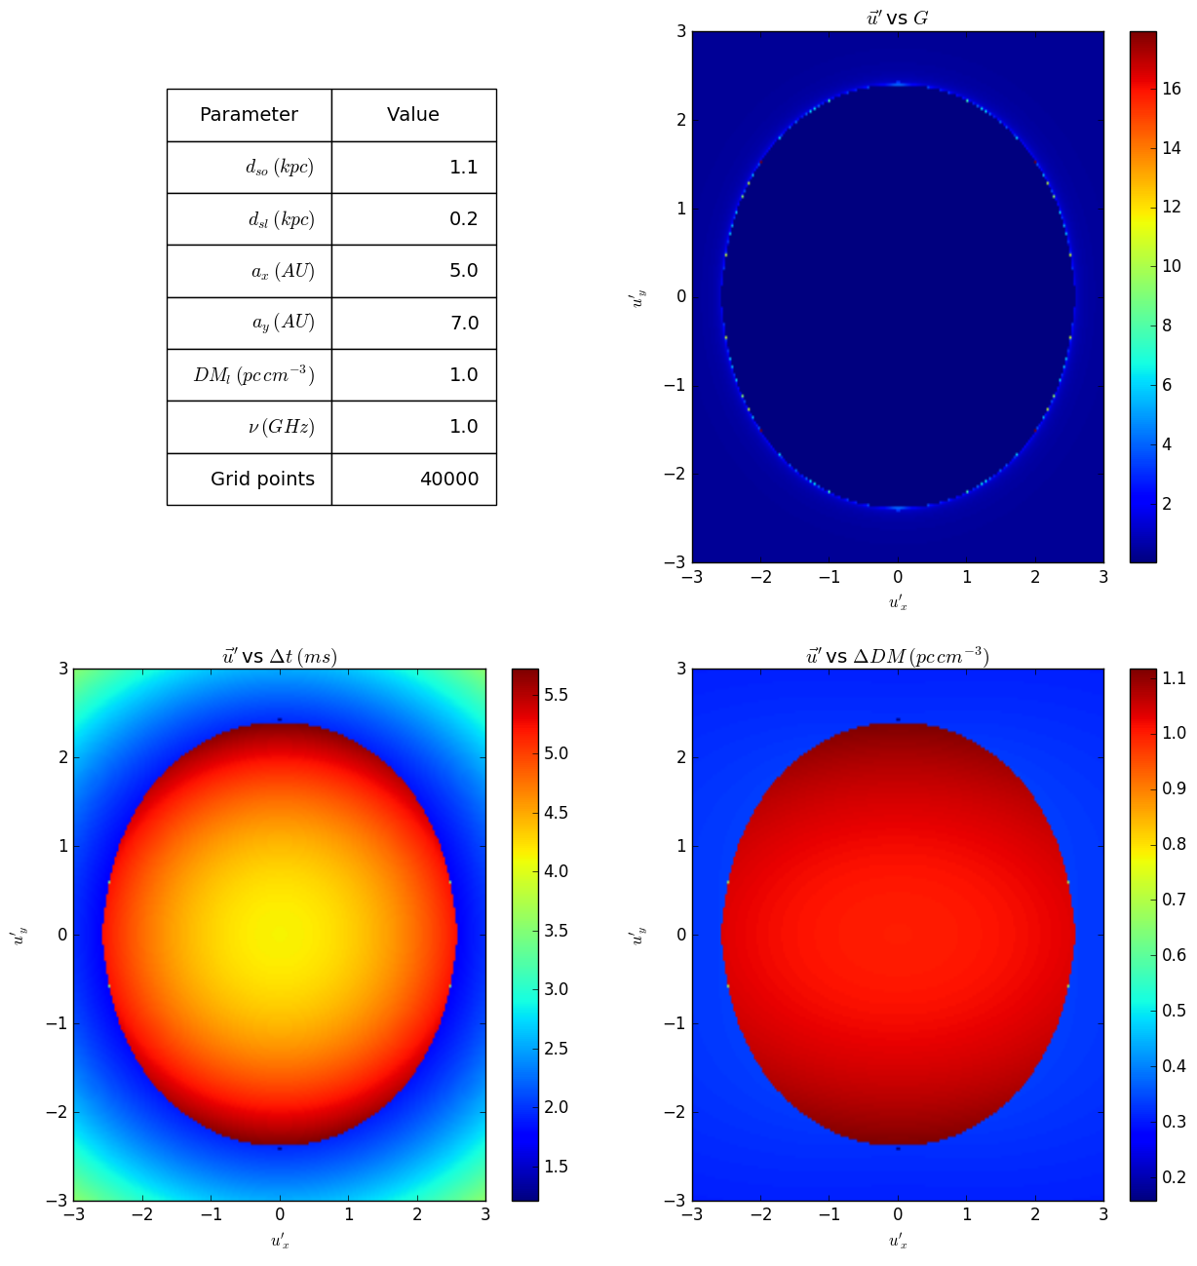
a_{x} and a_{y} are parameters that describe the lens size.
u'_{x} = x'/a_{x}, u'_{y} = y'/a_{y}

Slide 17
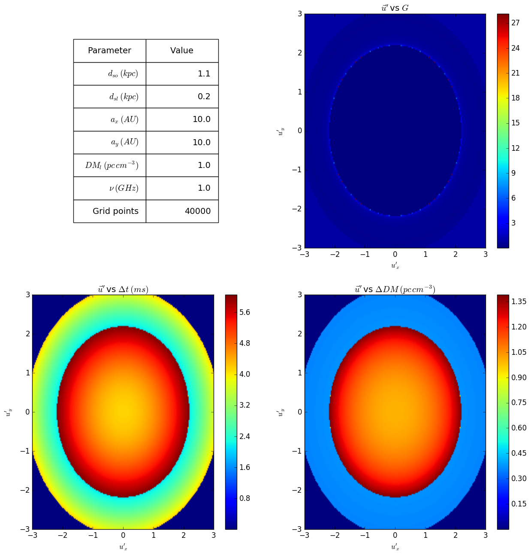

Slide 18
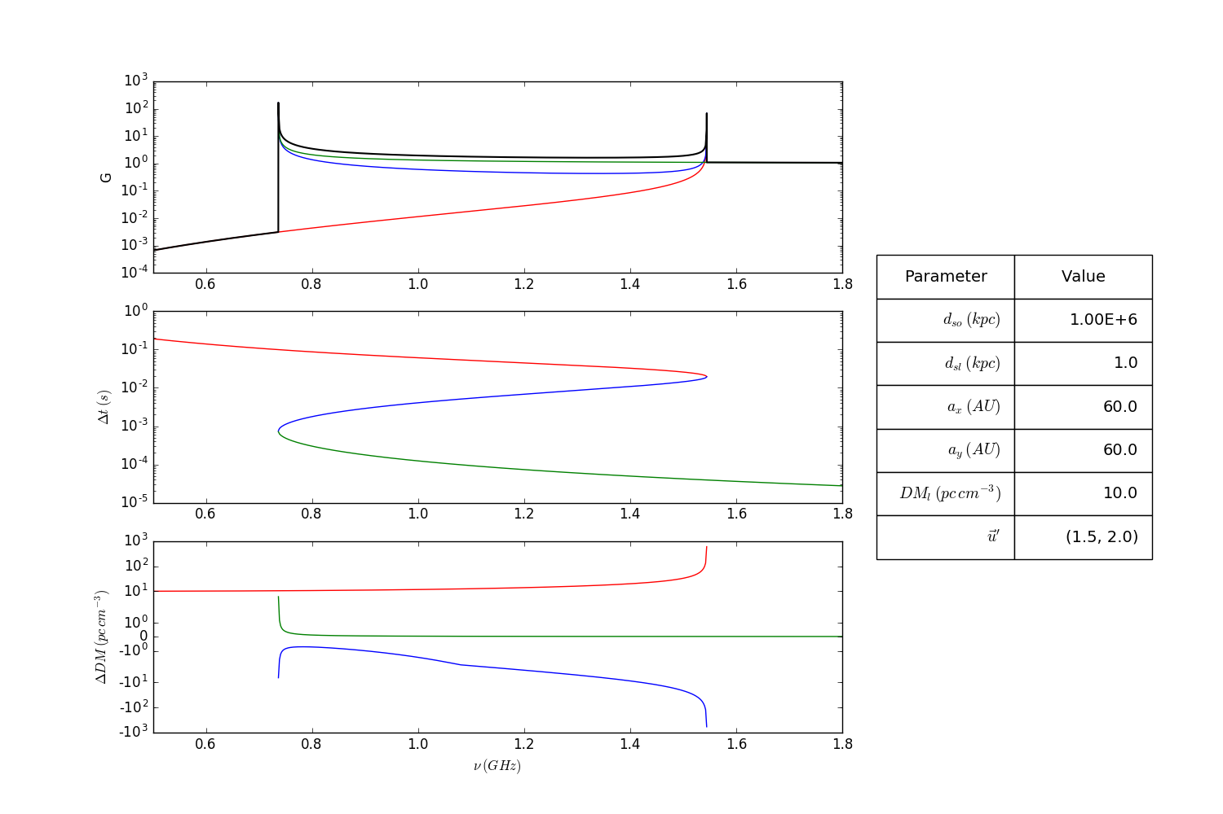

Slide 19
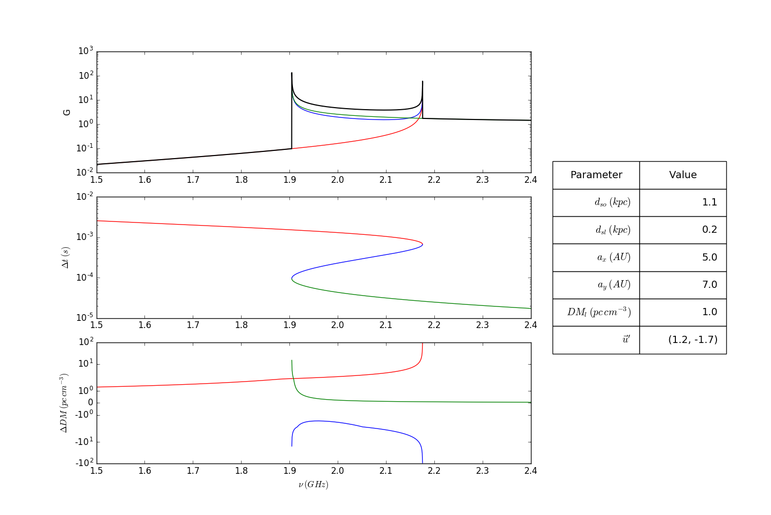

Slide 20
Issues

Slide 21
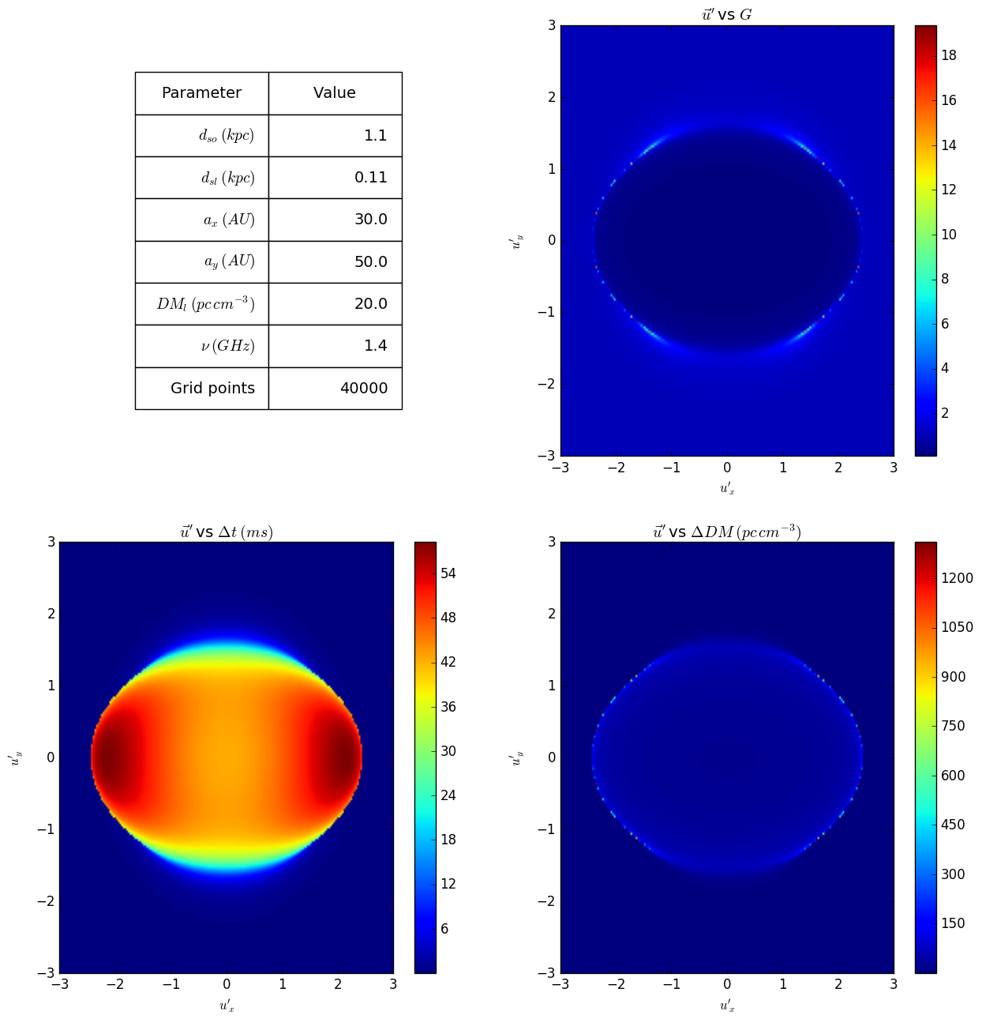

Slide 22
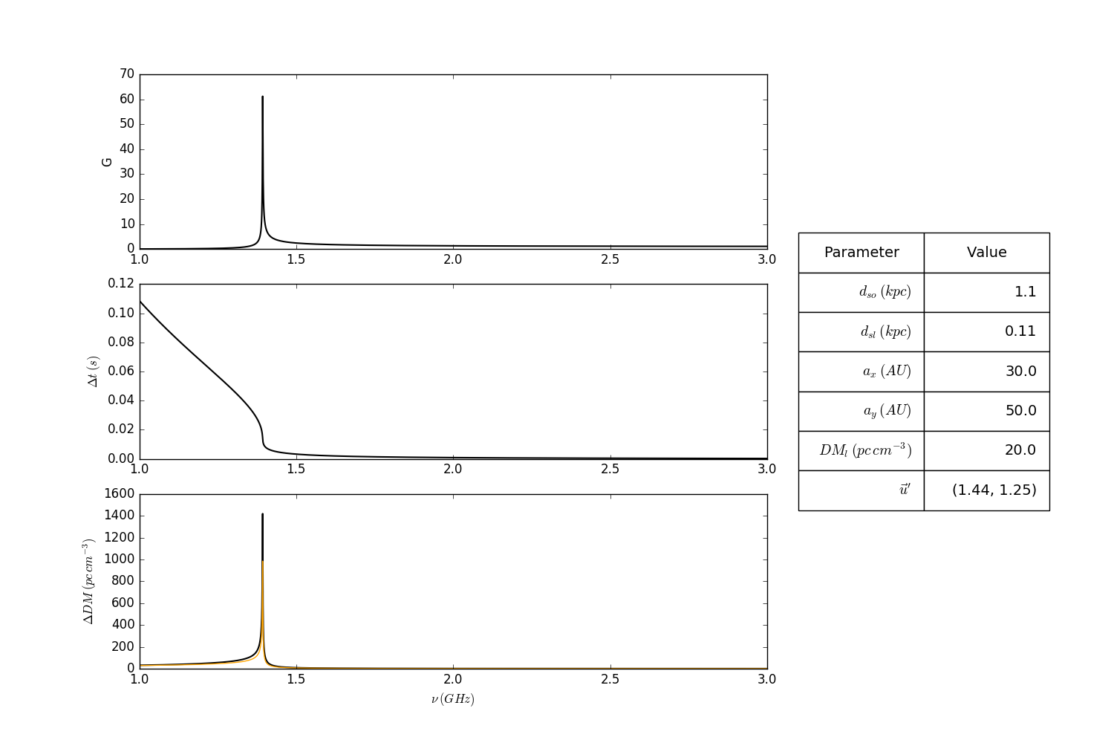

Slide 23
Going Forward
Behavior near caustics: right now the infinity is being removed by using next term in the Taylor series of the stationary phase method.
Not accurate. A better way would be to do it using Airy integrals.

Slide 24
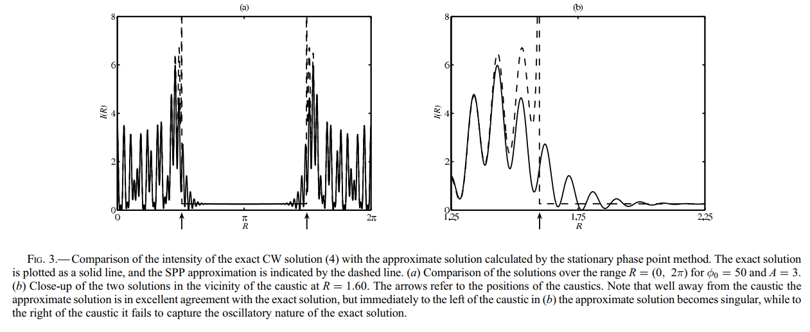
Obtained from Melrose (2006).

Slide 25
Going Forward
The geometric term in the arrival time perturbation is derived purely from geometrical optics. Its possible that a physical optics correction resolves the issue of large derivatives of Δt at non caustic locations.
Try to find reasonable ways to fit to data. The presence of many free parameters makes it hard to do it systematically.

Slide 26
Going Forward
Extend current plots to include slices across u' plane, and construct animations that show how plots change as functions of frequency and location.
Implement ray tracing model to aid in the finding of caustic locations and initial guesses for the root finding algorithm.

Slide 27
References
Cordes, J. M., Wasserman, I., et al. Lensing of Fast Radio Bursts by Plasma Structures in Host Galaxies. 2017, ApJ, 842, 35.
Clegg, A. W, Fey, A. L., Lazio, T. J. W. The Gaussian Plasma Lens in Astrophysics: Refraction. 1998, ApJ, 496, 253.
Melrose, D. B., Watson, P. G., Scintillation of Radio Sources: The Role of Caustics. 2006, ApJ, 647, 1131.
Goodman, J. J., et al. The Effects of Caustics on Scincillating Radio Sources. 1987, MNRAS, 229, 73.
Cooke, J. C. Stationary Phase in Two Dimensions. 1982, IMA J. Appl. Math, 29, 25.
Tuntsov, A. V., et al. Dynamic Spectral Mapping of Interstellar Plasma Lenses. 2016, ApJ, 817, 176.

